Slide 1
Annual Work Plan & Budget 2020-21
UT of Dadra & Nagar Haveli and Daman & Diu

Slide 2
Coverage of Institutions 31.3.2020
District | PAB Approved |  |  | Covered
 | Primary Schools | Upper primary Schools | Total | Primary Schools | Upper primary Schools | Total
D&NH | 161 | 119 | 280 | 161 | 119 | 280
Daman | 33 | 30 | 63 | 33 | 29 | 62
Diu | 16 | 13 | 29 | 15 | 11 | 26
TOTAL | 210 | 162 | 372 | 209 | 159 | 368
Working Days
District | PAB Approved | Covered
D&NH | 240 | 240
Daman | 234 | 233
Diu | 234 | 233

Slide 3
Comparison Statement of Coverage of Students of F.Y 2018-19 and 2019-20
 | 2018-19 |  |  | % Against PAB | % Against Enrol. | 2019-20 |  |  | % Against PAB | % Against Enrol.
D&NH | PAB approved | Enrollment | Opted Children |  |  | PAB approved | Enroll ment | Opted
Primary | 24,280 | 28552 | 22107 | 91.05 | 77.43 | 23,000 | 30036 | 23375 | 101.63 | 77.82
Upper primary | 11,500 | 14315 | 10280 | 89.39 | 71.81 | 11,000 | 13778 | 10230 | 93.00 | 74.25
Total (A) | 35780 | 42867 | 32387 | 90.52 | 75.55 | 34000 | 43814 | 33605 | 98.84 | 76.70
Daman
Primary | 7300 | 9135 | 6835 | 93.63 | 74.82 | 7239 | 9808 | 6639 | 91.71 | 67.69
Upper primary | 4550 | 5578 | 4342 | 95.43 | 77.84 | 4661 | 5489 | 4014 | 86.12 | 73.13
Total (B) | 11850 | 14713 | 11177 | 94.32 | 75.97 | 11900 | 15297 | 10653 | 89.52 | 69.64
Diu
Primary | 2100 | 2218 | 2081 | 99.10 | 93.82 | 2211 | 2310 | 2125 | 96.11 | 91.99
Upper primary | 2050 | 1896 | 1750 | 85.37 | 92.30 | 1889 | 1853 | 1659 | 87.82 | 89.53
Total (C) | 4150 | 4114 | 3831 | 92.31 | 93.12 | 4100 | 4163 | 3784 | 92.29 | 90.90
Grand Total | 51780 | 61694 | 47395 | 91.53 | 76.82 | 50000 | 63274 | 48042 | 96.08 | 75.93

Slide 5
Student taken Part in 2019-20 31.03.2020
D&NH | PA B approved | Enrollment | Opted Children | % Against Enrollment | % Against PAB
Primary | 23000 | 30036 | 23375 | 77.82% | 101.63%
Upper primary | 11000 | 13778 | 10230 | 74.25 % | 93.00 %
Total (A) | 34000 | 43814 | 33605 | 76.70 % | 98.84 %
Daman
Primary | 7239 | 9808 | 6639 | 67.69% | 91.71%
Upper primary | 4661 | 5489 | 4014 | 73.13% | 86.12%
Total (B) | 11900 | 15297 | 10653 | 69.64% | 89.52%
Diu
Primary | 2211 | 2310 | 2125 | 91.99% | 99.77%
Upper primary | 1889 | 1853 | 1659 | 89.53% | 87.82%
Total (C) | 4100 | 4163 | 3784 | 90.90% | 92.29%
Grand Total | 50000 | 63274 | 48042 | 75.93% | 96.08%

Slide 6
Food-grain details (Figure in MTs)
District | Allotment | Op. Bal | Lifted | Utilize | Clo. Bal
D&NH | 948.00 | 26.77 | 623.34 | 648.06 | 2.05
Daman | 332.99 | 25.93 | 229.61 | 294.97 | -39.43*
Diu | 118.05 | 18.29 | 108.36 | 106.58 | 20.07
Total | 1399.04 | 70.99 | 961.31 | 1049.61 | -17.31
Note: - Daman District has utilized 50 MTs rice from the1st QTR of 2020-21.
Payment to FCI
District | Lifted (in MTs) | Bill Raised (Rs. In Lakhs) | Bill Paid (Rs. In Lakhs)
D&NH | 623.34 | 18.89 | 18.89
Daman | 229.61 | 6.96 | 6.96
Diu | 108.36 | 3.25 | 3.25
Total | 961.31 | 29.10 | 29.10

Slide 7
Component wise Central Share Allotment Released & Expenditure for the year 2019-20 (Amount. In Lakh)
 | Cost of food Grains | Cooking cost | Honorarium to CCH | Transport Assistant | MME | Total
D&NH
Allotment | 28.73 | 424.43 | 92.60 | 13.27 | 14.75 | 573.78
Release | 27.90 | 424.44 | 92.60 | 12.89 | 15.06 | 572.89
Expenditure | 18.89 | 416.06 | 88.98 | 6.77 | 15.06 | 545.76
Daman
Allotment | 10.08 | 144.68 | 21.00 | 4.33 | 4.86 | 184.95
Release | 9.15 | 149.52 | 21.00 | 3.92 | 5.02 | 188.61
Expenditure | 6.96 | 132.05 | 18.62 | 2.90 | 5.02 | 165.55
DIU
Allotment | 3.58 | 51.29 | 11.00 | 1.54 | 1.83 | 69.24
Release | 3.18 | 52.41 | 11.00 | 1.36 | 1.77 | 69.72
Expenditure | 3.25 | 47.71 | 10.72 | 1.20 | 1.77 | 64.65
Grand Total
Allotment | 42.39 | 620.4 | 124.6 | 19.14 | 21.44 | 827.97
Release | 40.23 | 626.37 | 124.6 | 18.17 | 21.85 | 831.22
Expenditure | 29.10 | 595.82 | 118.32 | 10.87 | 21.85 | 775.96

Slide 8
Component wise UT Share Allotment Released & Expenditure for the year 2019-20 (Amount. In Lakh)
D&NH | Cost of food Grains | Cooking cost | Honorarium to CCH | Trans.Assit | MME | Total
Allotment | 0.00 | 763.27 | 251.97 | 0.00 | 0.00 | 1015.24
Release | 0.00 | 218.00 | 216.00 | 0.00 | 0.00 | 434.00
Expenditure | 0.00 | 219.92 | 213.25 | 0.00 | 0.00 | 433.17
Daman
Allotment | 0.00 | 361.34 | 57.13 | 0.00 | 11.53 | 430.00
Release | 0.00 | 23.57 | 50.94 | 0.00 | 0.00 | 74.51
Expenditure | 0.00 | 23.57 | 50.94 | 0.00 | 0.00 | 74.51
Diu
Allotment | 0.00 | 69.85 | 29.92 | 0.00 | 1.77 | 116.34
Release | 0.00 | 69.85 | 29.92 | 0.00 | 1.14 | 108.03
Expenditure | 0.00 | 69.85 | 29.92 | 0.00 | 1.14 | 108.03
Grand Total
Allotment | 0.00 | 1194.46 | 339.02 | 0.00 | 13.3 | 1561.58
Release | 0.00 | 311.42 | 296.86 | 0.00 | 1.14 | 616.54
Expenditure | 0.00 | 313.34 | 294.11 | 0.00 | 1.14 | 615.71
Note: - The Cooking cost per child is fulfilled only through Central Share. Additional expenditure of Sweet Rs. 2.87/- per child only borne through UT Share. Before The AKF started the UT has allotted more share as per the previous year.

Slide 9
Unit cooking cost 2019-20 31.03.2020
Year | Primary |  |  | Upper Primary
D&NH | Central | UT | Total | Central | UT | Total
 | 4.48 | 2.87 | 7.35 | 6.71 | 2.87 | 9.58
Daman | 4.48 | 2.87 | 7.35 | 6.71 | 2.87 | 9.58
DIU | 4.48 | 7.99 | 12.47 | 6.71 | 8.20 | 14.91
Note: Sukhdi & Lapsi is provided from UT Grant in D&NH and Daman

Slide 10
Menu served by APF in D&NH and Daman
Day | Menu
MONDAY | Rice, Dal Tadka Desi Chana/Lobiya/Rajma/Chhole Aloo Masala, Sukhadi or Lapsi
TUESDAY | Rice, Mix Dal, Mix veg, Sukhadi or Lapsi
WEDNESDAY | Rice, Dal Fry, Desi Chana/ Lobiya/Rajma/Chhole Aloo Masala, Sukhadi or Lapsi
THURSDAY | Rice, Sambhar Mix Veg, Sukhadi or Lapsi
FRIDAY | Veg Khichadi, Veg Jalfrezi, Sukhadi or Lapsi
SATURDAY | Rice, Dal Fry, Desi Chana/ Lobiya/ Rajma/ Chhole Aloo Masala, Sukhadi or Lapsi

Slide 11
Budget Proposal 2020-21

Slide 12
Proposal for 2020-21 (Primary Section)
State/UT | No. of Schools | Enrollment | Beneficiaries | Proposed Children
UT Adm. Of DNH and Daman & Diu | 209 | 42154 | 32139 | 34887
Addition of one school under local body under SMC - Red Cross School in D&NH

Slide 13
Proposal for 2020-21 (Upper Primary Section)
State/UT | No. of Schools | Enrollment | Beneficiaries | Proposed Children
UT Adm. Of DNH and Daman & Diu | 159 | 21120 | 15903 | 16443

Slide 14
Unit Cost for the year 2020-21
Cooking Cost D&NH and Daman | Primary |  |  | Upper Primary
 | Cent. | UT | Total | Cent. | UT | Total
 | 4.97 | 2.87 | 7.84 | 7.45 | 2.87 | 10.32
Cooking Cost Diu | 4.97 | 7.99 | 12.96 | 7.45 | 8.20 | 15.65
Propose working Days for the year 2020-21 = 241 Days Honorarium of Cook-cum-Helper – Rs. 163.20/- per day/per cook as per half day daily wages rate. Rs. 1000/- Central share and remaining amount disbursed from the UT share.

Slide 15
Food-grain details (Figure in MTs)
District | Food grains (Rice) proposed for F.Y 2020-21
 | Primary | Upper Primary | Total
D&NH | 614.55 | 369.81 | 984.36
Daman | 171.11 | 159.06 | 330.17
Diu | 55.12 | 65.54 | 120.66
Total | 840.78 | 594.41 | 1435.19
Payment to FCI

Slide 16
Proposal for the year 2020-21 under MDM (Amount in lakh)
 | Food-grain | Cooking Cost | Honorarium | Transport Assistance | MME | Total
 |  |  |  |  |  | Budget
D&NH
Central Share | 29.82 | 489.1 | 92.60 | 13.77 | 30.00 | 655.29
UT Share | 0.00 | 247.12 | 271.6 | 0.00 | 0.00 | 518.72
Total | 29.82 | 736.22 | 364.2 | 13.77 | 30.00 | 1174.01
Daman
Central Share | 10.00 | 164.04 | 18.6 | 4.63 | 20.00 | 217.27
UT Share | 0.00 | 79.54 | 54.56 | 0.00 | 0.00 | 134.10
Total | 10.00 | 243.58 | 73.16 | 4.63 | 20.00 | 351.37
DIU
Central Share | 3.66 | 59.94 | 10.8 | 1.69 | 10.00 | 86.09
UT Share | 0.00 | 79.87 | 31.68 | 0.00 | 0.00 | 111.55
Total | 3.66 | 139.81 | 42.48 | 1.69 | 10.00 | 197.64
Grand Total
Central Share | 43.48 | 713.08 | 122.00 | 20.09 | 60.00 | 958.65
UT Share | 0.00 | 406.53 | 357.84 | 0.00 | 0.00 | 764.37
Total | 43.48 | 1119.61 | 479.84 | 20.09 | 60.00 | 1723.02

Slide 17
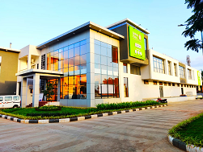
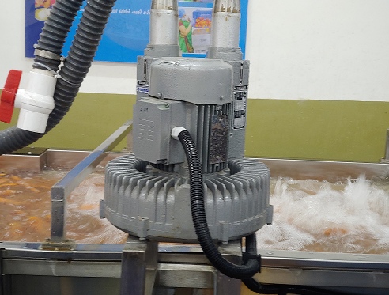
Best Practice
The Akshaya Patra Foundation has been implemented in DNH and Daman since 16th July, 2019.
Automated Vegetable washer Machine used by Akshaya patar foundation at Centralized Kitchen
.

Slide 18
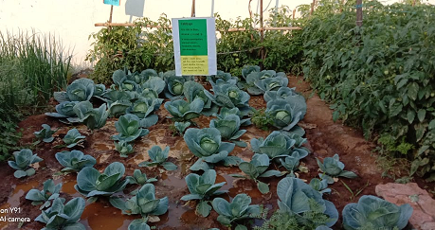
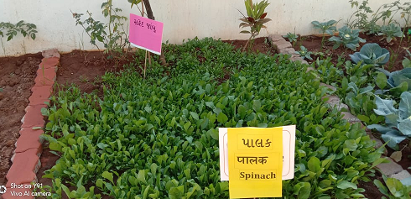
Best Practice
Green Vegetable (cabbage, cauliflower, ladyfinger) planted in school premises
Green leafy vegetable such as spinach, coriander, curry leaf and fenugreek leaves

Slide 19
Compost Pit in Diu School
Implemented Compost Pit in District Panchayat School area in Diu.

Slide 20
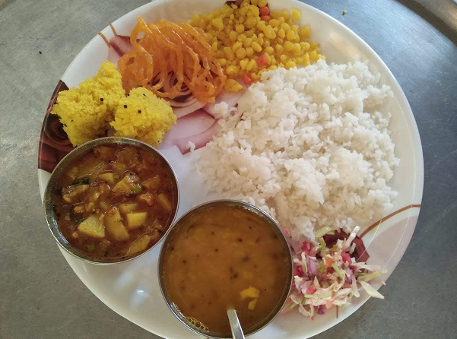
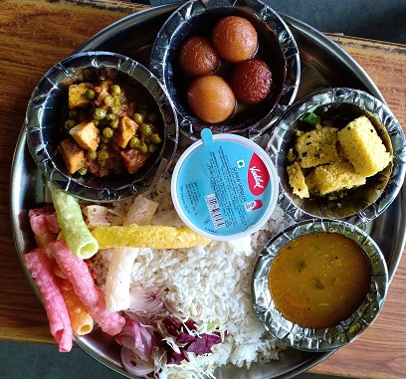
Tithi Bhojan served by Donor
Under Thithi Bhojan any such item such as : Sweet items ,Namkeen , Vegetable/Panner , Ice cream is provided by Donor

Slide 21
Issues
Sr. No. | Particular
1 | MME fund at 2.7% is not sufficient even for the salary of the staff working under the Mid Day Meal Scheme.

Slide 22
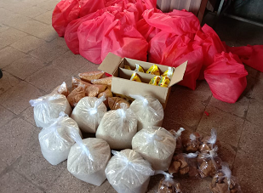
Kit Distribution
Due to the effect of COVID -19 Raw food grains Kit containing of 4kg of Rice, 1 kg of Tur Dal ,1 liter of Oil and 500 gram of Sukhadi to Primary student and 1 kg of Sukhadi to upper primary student Kit was provided to each enrolled student parents

Slide 23
Proposal of kit to be provided during summer Vacation
Name of State/UT: - UT Administration of DNH and Daman & Diu
As per the direction. UT Administration has decided to provide the following take home ration kit to all the enrolled students from Class I to VIII for DNH and Daman & Diu during COVID-19.
Name of the items | Quantity
Rice | 05 Kg
Toor Dal | 01 Kg
Oil | 01 Kg
Black Chana | 01 Kg

